Slide 1
Name:
William Dargan
Specification & learning objectives
By the end of this topic you will have studied:
The need for primary storage
The difference between RAM and ROM
The purpose of ROM in a computer system
The purpose of RAM in a computer system
Virtual memory
The need for secondary storage
Common types of storage: Optical, Magnetic, Solid state
Suitable storage devices and storage media for a given application
The advantages and disadvantages of different storage devices and storage media relating to these characteristics: Capacity, Speed, Portability, Durability, Reliability, Cost
Resources
We recommend the OCR endorsed text book from PG Online for use during your GCSE studies.
Craig'n'Dave videos for SLR 1.2
Notes:
Activity…

Slide 2

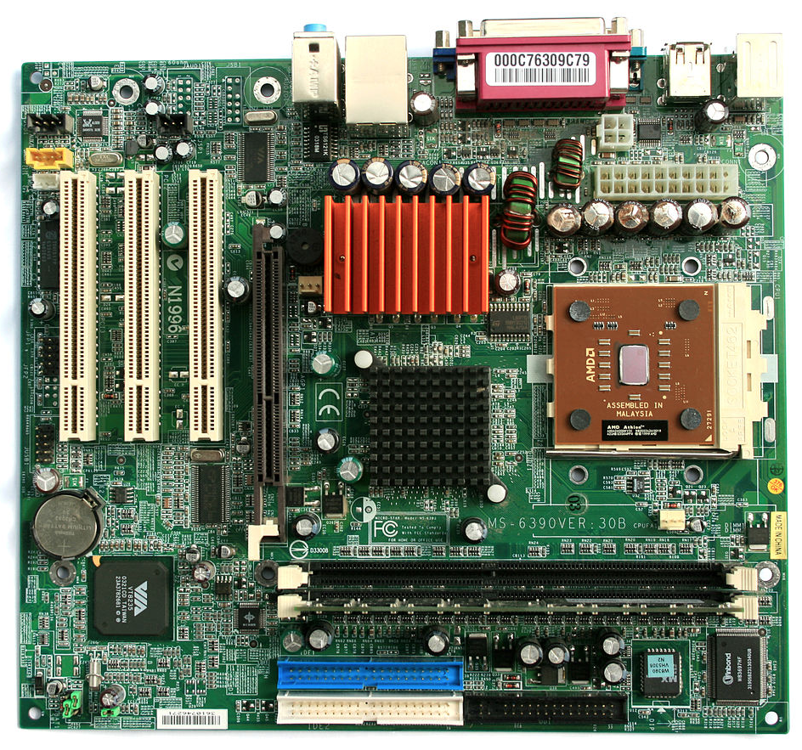
Virtual tour of the inside of a computer
Click here to return to the homepage
CPU
ROM / BIOS
RAM
Notes:
Identify and label the key components: CPU, ROM, RAM, BIOS, and draw a thick bordered box around them. (It doesn’t matter if you are not sure, just use a component that looks about right!)
Create a hyperlink from your label to the appropriate slide in this presentation. E.g. the link to ROM should be to slide 5.
Credit: image from Jonathan Zander, CC BY-SA 3.0, https://commons.wikimedia.org/w/index.php?curid=4994025

Slide 3
The CPU
Name
Central processing unit
Purpose
To fetch and execute instructions.
Components
Arithmetic logic unit: performs calculations and logic.
Control unit: decodes instructions and sends signals to control how data moves around the CPU.
Cache: fast access memory for frequently used instructions and data.
Registers: small fast memory used to help fetch and execute instructions.
Factors affecting the speed
Number of cores: independent processing units.
Clock speed: The number of cycles per second.
Cache: Temporary storage of instructions and data.
Notes:
There is nothing to do on this slide. It is here to show you the detail that is required in the next few slides.

Slide 4
RAM
Name
Random Access Memory
Purpose
Store data needed by the CPU.
Volatile
Data is deleted when the computer is turned off.
Read/Write
Notes:
3. Using the example shown on the ‘CPU’ slide as a guide, draw a box around the component, and insert a text box to write your notes…
4. Use the following headings to explain this component: Name (write the full name of the component), Purpose, Volatile or Non-volatile (explain what this means), Read or Read/Write.

Slide 5
ROM
Name
Read only memory
Purpose
Stores BIOS program to start the OS.
Non-Volatile
Data is not deleted when the computer is turned off.
Read
ROM
ROM can be used for other things such as game cartridges because nothing needs to be saved to them. E.g. disks in modern games consoles.
Notes:
5. Draw a box around the component, and insert a text box to write your notes…
6. Use the following headings to explain this component: Name (write the full name of the component), Purpose, Volatile or Non-volatile (explain what this means), Read or Read/Write.
7. How else can ROM be used in computer systems? E.g. games cartridges. Include some examples.

Slide 6
Virtual memory
Virtual memory is:
A section of the hard disk or solid state where programs that aren’t executing are stored.
Virtual memory is needed because:
RAM may not be large enough for all running programs.
The problem with using virtual memory is that:
It is very slow.
Notes:
8. Complete the boxes to explain the purpose of virtual memory.

Slide 7
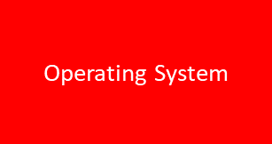
Example of virtual memory in use
Hard disk
Scenario: A user of a desktop PC has the operating system and presentation software open.
Virtual memory on disk
Stored programs on disk
Operating System
RAM
8Gb
Word processor app
Presentation app
Spreadsheet app
Presentation app
0Gb
Graphics app
If the user decides to open a graphics application to edit an image for the presentation too, the problem is that:
Video editing app
There isn’t enough space in RAM.
Notes:
9. By copying the appropriate boxes from the hard disk into the memory, show how the memory is used in this scenario: a user has Windows and PowerPoint open.
10. Explain the problem of trying to put Photoshop in the memory space too.

Slide 8
Example of virtual memory in use
Hard disk
Scenario: A user of a desktop PC has the operating system, presentation and a graphics application open. The user is not currently working on the open presentation, just editing a photograph to include on a slide later.
Virtual memory on disk
Stored programs on disk
Presentation app
Operating System
RAM
8Gb
Operating System
Word processor app
Graphics app
Spreadsheet app
Presentation app
0Gb
Graphics app
Explanation of the use of virtual memory in this scenario:
Video editing app
The presentation app has been moved to virtual memory and there is enough space for the graphics app.
Notes:
11. Show how the problem can be resolved by using virtual memory.
12. Explain what has happened.

Slide 9
Example of virtual memory in use
Hard disk
Scenario: The user switches back to the presentation software without closing the graphics application.
Virtual memory on disk
Stored programs on disk
Graphics app
Operating System
RAM
8Gb
Operating System
Word processor app
Presentation app
Spreadsheet app
Presentation app
0Gb
Graphics app
Explanation of the use of virtual memory in this scenario:
Video editing app
The graphics app has been moved to virtual memory and the presentation app has been moved to RAM.
Notes:
13. Explain and illustrate what happens when a program in virtual memory is needed again by the CPU.

Slide 10
Why more RAM increases the speed of a computer
Hard disk
Scenario: The user doubles the amount of RAM in the computer to 8Gb, turns on the computer, opens the presentation app and the graphics app to continue working on the presentation.
Virtual memory on disk
Stored programs on disk
Operating System
RAM
16Gb
Operating System
Word processor app
Spreadsheet app
Presentation app
Presentation app
Graphics app
8Gb
Graphics app
Doubling the size of the RAM makes the computer faster because:
Programs need to be moved between RAM and virtual memory less often.
Video editing app
0Gb
Notes:
14. Illustrate what happens if the user doubles the amount of RAM in the computer.
15. Explain why this makes the computer significantly faster.

Slide 11
The need for secondary storage
ROM can’t be used to save files because:
It is read only
RAM can’t be used to save files because:
It is volatile
Therefore secondary storage is needed because:
It is read and write and is not volatile.
Types of secondary storage
RAM, ROM, registers and cache are referred to as primary storage. The operating system, programs and data are held in secondary storage when not in use.
The term tertiary storage is used to describe backups and archives of large amounts of data.
Secondary storage can be:
Magnetic
Solid State
Optical
Data is stored using magnetism.
Data is stored using semiconductor chips.
Data can be stored using ‘pits and lands’.
Notes:
16. Complete the boxes to explain the purpose of secondary storage.

Slide 12
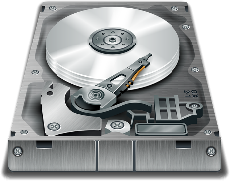
Examples of secondary storage
HARD DISK
Image
Type | Magnetic
Uses | Internal storage for PC/laptop. Holds operating system and program files.
Characteristics | Moving drive head which has to move to each part of a data file. Hard disks perform better if they are defragmented.
Reliability and Durability | 8 | Damaged by impacts.
Portability | 7 | Can be portable, but are larger and heavier.
Capacity | 10 | Very high: 2-8TB.
Cost | 7 | Cheap.
Data access speed | 7 | Fast.
SOLID STATE FLASH MEMORY
Image
Type | Solid State
Uses | Portable storage.
Characteristics | Silicon chips.
Reliability and Durability | 9 | Hard do break.
Portability | 10 | Light weight.
Capacity | 6 | Relatively low capacity.
Cost | 7 | High cost per GB.
Data access speed | 8 | Relatively fast.
Notes:
17. Create a set of “Top Trump” cards for each of the storage devices. An example is shown for a hard disk.
The number values should indicate the relative performance compared to all the other devices.
Research the typical capacity range for the device on the web.
An alternative activity could be to create an illustrated animation, a documentary film or presentation.

Slide 13
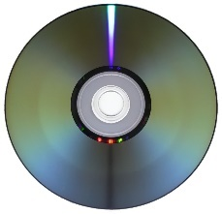
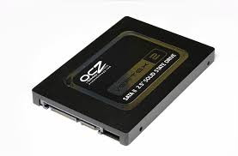
Examples of secondary storage
CD-R
Image
Type | Optical
Uses | Mass distribution of software.
Characteristics | Pits and lands which are read by a laser. Slow.
Reliability and Durability | 5 | Easily scratched
Portability | 9 | Extremely light weight.
Capacity | 5 | Small
Cost | 9 | Very cheap.
Data access speed | 5 | Relatively slow.
SOLID STATE DRIVE
Image
Type | Solid State
Uses | Fast access storage.
Characteristics | Silicon computer chips. High speed.
Reliability and Durability | 10 | Difficult to damage.
Portability | 9 | Light weight.
Capacity | 8 | Quite large.
Cost | 7 | Quite expensive per GB.
Data access speed | 9 | Very fast.
Notes:
Did you know using a lowercase letter refers to bits, e.g. 34Kb = 34 kilobits, whereas using uppercase letter refers to bytes, e.g. 34KB = 34 kilobytes. Lowercase (bits) is used for data transmission speeds. Uppercase (bytes) is used for storage capacity. This is not important for exams, but thought you’d like to know.

Slide 14
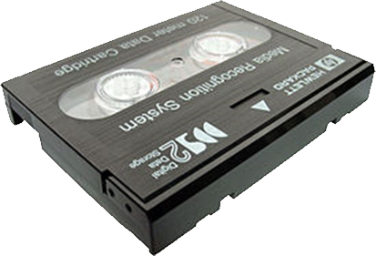
Examples of secondary storage
Blu-Ray™
Image
Type | Optical
Uses | Video and Photos.
Characteristics | Blue laser for increased storage.
Reliability and Durability | 5 | Easily scratched.
Portability | 9 | Extremely light weight.
Capacity | 8 | High capacity.
Cost | 8 | Relatively high compared to CD-R.
Data access speed | 5 | Relatively slow.
DAT TAPE
Image
Type | Magnetic
Uses | Extremely large backups.
Characteristics | Magnetic tape which is wound around spools.
Reliability and Durability | 7 | Tape is easily damaged.
Portability | 7 | Depends on size.
Capacity | 10 | Highest capacity of all storage types.
Cost | 9 | Very low cost per GB.
Data access speed | 2 | Extremely slow.

Slide 15
Suitability of devices
Alicia is using a helmet mounted camera to record footage whilst snowboarding. Suggest two reasons why a solid state memory card is a good choice for secondary storage in this scenario, and two reasons why a hard disk would be unsuitable.
Greg is considering whether to download games for his games console from an online store, or whether to purchase the physical disks instead. Give reasons why he may choose one option or another.
Notes:
18. Complete the boxes.

Slide 16
Suitability of devices
Abdul wants to keep a backup of his photos, and is considering using DVD-R disks. Give two advantages and two disadvantages of this method.
Sarah is a student who needs access to her school files at home and school. She currently emails the documents she is working on home, and keeps a copy of all her school work on the school servers. She then emails the files back into school and downloads the attachments to the school server when she is back in school. Suggest better alternatives for Sarah to work with her files, and reasons why she might not choose this option.
Notes:
19. Complete the boxes.

Slide 17
Suitability of devices
Scott is getting a new computer. He has three options for secondary storage. He could choose:
a 6TB hard disk drive
a 2TB solid state drive
a hybrid 500GB solid state with a 4TB hard disk
For each option give reasons why Scott may choose that option instead of the alternatives.
Notes:
20. Complete the box.

Slide 18
Assessment |  |  |  | Target: |  | Overall grade:
Minimum expectations by the end of this unit
□ | You should have learnt terms 16-29 from your GCSE Level Key Terminology during this unit.
□ | You have completed all the pages of the workbook
□ | Score 80% in the end of unit test.
Feedback
Breadth |  | Depth |  |  | Understanding
□ All aspects complete |  | □ Excellent level of depth |  |  | □ All work is accurate
□ Most aspects complete |  | □ Good level of depth |  |  | □ Most work is accurate
□ Some aspects complete |  | □ Basic level of depth shown |  |  | □ Some work is accurate
□ Little work complete |  | □ Little depth and detail provided |  |  | □ Little work is accurate
Comment & action |  |  | Student response

Slide 19
Reflection & Revision checklist
Confidence | Clarification
☹ 😐 ☺ | I can explain the need for primary storage
☹ 😐 ☺ | I can explain the difference between RAM and ROM
☹ 😐 ☺ | I can explain the purpose of RAM in a computer system
☹ 😐 ☺ | I can explain the purpose of ROM in a computer system
☹ 😐 ☺ | I can explain the need for virtual memory
☹ 😐 ☺ | I can explain the need for secondary storage
☹ 😐 ☺ | I can explain common types of storage, including: Optical, Magnetic, Solid state
☹ 😐 ☺ | I can suggest suitable storage devices and storage media for a given application
☹ 😐 ☺ | I can explain the advantages and disadvantages of different storage devices / media in relation to the following characteristic: capacity
☹ 😐 ☺ | I can explain the advantages and disadvantages of different storage devices / media in relation to the following characteristic: speed
☹ 😐 ☺ | I can explain the advantages and disadvantages of different storage devices / media in relation to the following characteristic: portability
☹ 😐 ☺ | I can explain the advantages and disadvantages of different storage devices / media in relation to the following characteristic: durability
☹ 😐 ☺ | I can explain the advantages and disadvantages of different storage devices / media in relation to the following characteristic: reliability
☹ 😐 ☺ | I can explain the advantages and disadvantages of different storage devices / media in relation to the following characteristic: cost
My revision focus will need to be:

